Slide 1
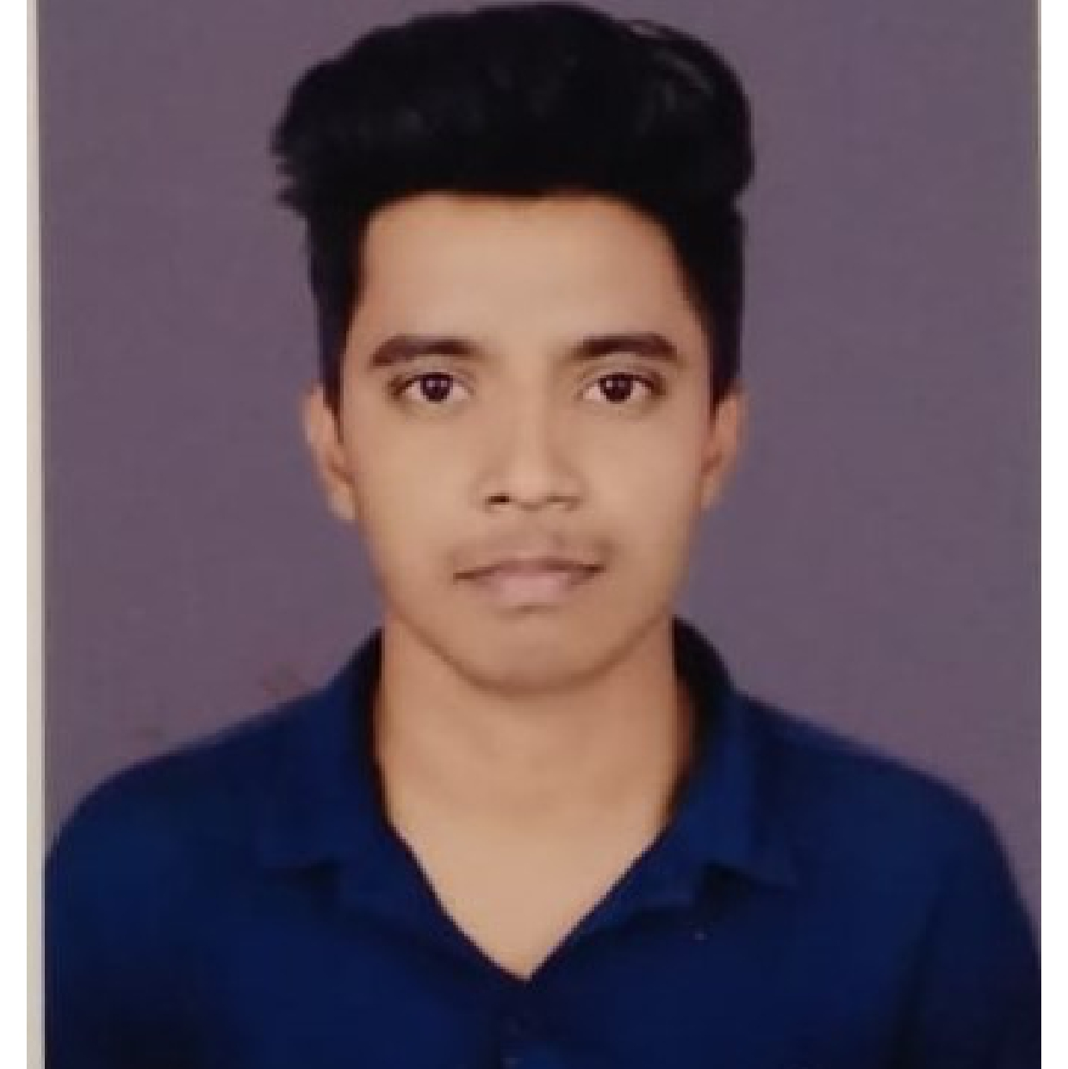


Ranjit Raj
Bachelor of Technology in
Computer Science and Engineering : 2018 - 2022
Analyst
Skills
Java 8 /J2EE | Java Basics, OOPS, Generics, Collections, Arrays, Loops, Lambda Exp, Stream API Junit.
Spring core | IOC & Dependency Injection, Autowire
Spring REST | REST controllers, Implementation of GET, POST, PUT & DELETE, & Exception Handling, Testing Services, Controller & Repository layer
Spring Data JPA | Implement spring Data repositories,
Spring Boot Microservices | Spring Boot Starters, annotations, Messaging Service, Sync/Async comms, Swagger API documents
Spring Cloud | Eureka Server, Spring cloud API Gateway, Hystrix, Netflix Zuul & Config Server
Angular | Components, Services, Modules, Routing, Forms & Validation, Testing using Jasmine & Karma
Database | MongoDB No Sql, My SQL Basics
UI Tech | HTML 5 & CSS 3,JavaScript, ES6 & TypeScript Reusable templates, Angular material,bootstrap
Tools | Git, Postman, Swagger, Maven, STS,VS code
Add On skills | Self learning, Self Motivated
Bangalore
ranjit.raj@capgemini.com
+91 9801474493
A4
Full Stack Developer
Ready to learn new technologies and implement them to further improve my knowledge.
Hands on experience in creating microservices with Springboot, Spring Cloud API Gateway, Eureka server, microservices.
Proficient in creating Single page Web Application in Angular with Authentication with Angular reactive forms, angular routing, HTML.
Hands on experience in implementing Mongo DB with spring boot
Experience in creating documentation with swagger and Postman and in unit testing using Junit
Development experience in creating microservices for backend and connecting all
E-Commerce Shopping Cart Application
Completed end to end case study of Shopping Cart Application.
For Backend : Implemented using microservices and connect them on server using Eureka Server. Implemented Swagger and postman to perform CRUD operations. MongoDB for database. API Gateway for performing all request. Which act as a barrier between User and Microservices.
For Frontend : Implemented using Angular 6. Created different Components and Services. HTML for outlook and CSS for design and color. Connected frontend and backend in Services from when request is sent to API Gateway.
Completed DSA course and got completion certificate from GEEKSFORGEEKS
Check out my work on GitHub & Video Profile

